Slide 1




DOGS
Mobile Application Development Finals Presentation
報告人：張家豪
指導老師：蔡坤孝

Slide 2

REVIEW
METHODS
FEATURES
CONTENT
GROW
References

Slide 3

PART 1
REVIEW

Slide 4
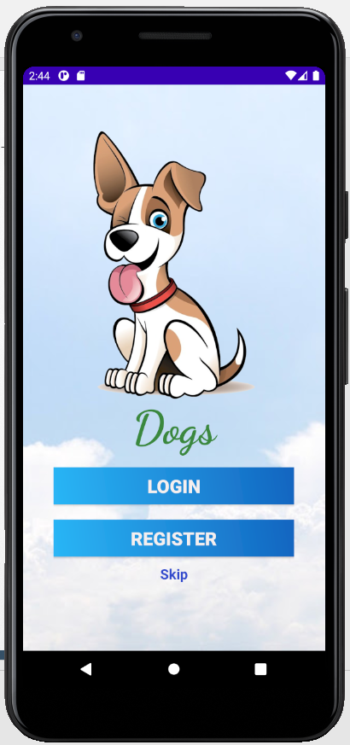
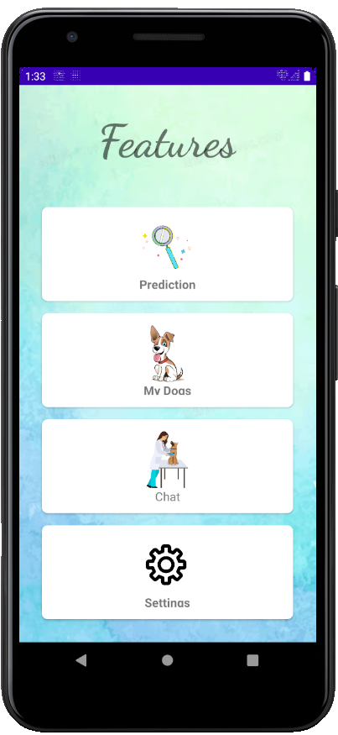
1.1 WHAT IS THE “DOGS”??
The most interesting and joyful APP is now on your Android Phone.You will have many countless hours of fun and entertainment.
The DOGS have four features
-Prediction
-My Dogs
-Chat
-Settings

Slide 5
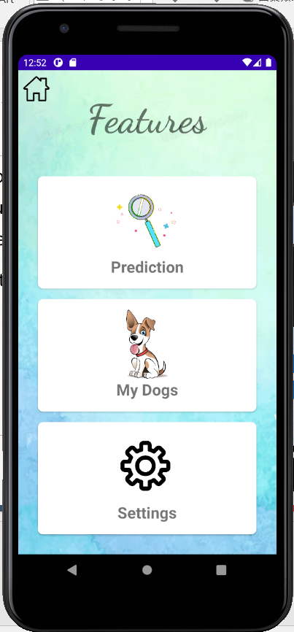
1.2 NOW
The most interesting and joyful APP is now on your Android Phone.You will have many countless hours of fun and entertainment.
The DOGS have three features
-Prediction
-My Dogs
-Settings

Slide 6
PART 2
METHODS

Slide 7





2.1 METHODS
BASIC CODE
DATABASE
CNN
UI
请在这里输入您的文字；请在这里输入您的文字；请在这里输入您的文字；请在这里输入您的文字。
请在这里输入您的文字；请在这里输入您的文字；请在这里输入您的文字；请在这里输入您的文字。
请在这里输入您的文字；请在这里输入您的文字；请在这里输入您的文字；请在这里输入您的文字。

Slide 8
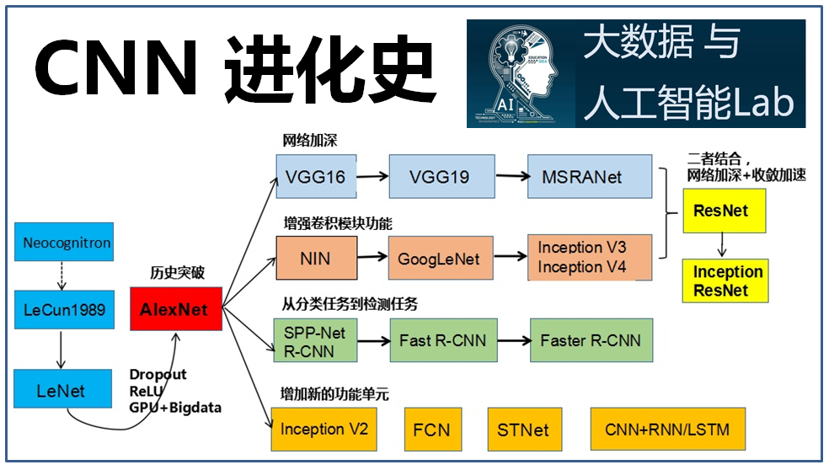

2.2 ALGORITHM
What is an Algorithm??
An algorithm is a list of rules to follow in order to solve a problem.
CNNDevelopment
DENSENET

Slide 9
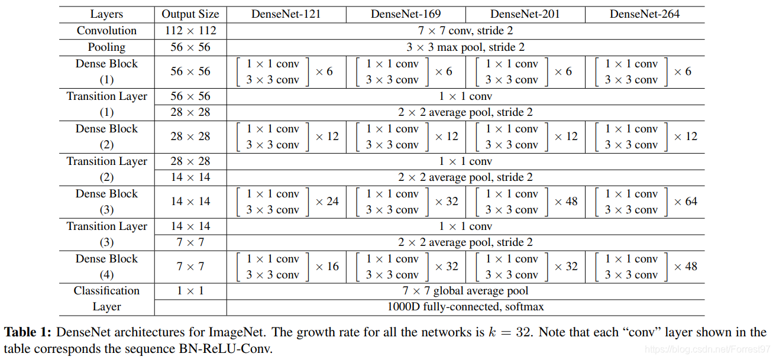
2.3 DENSENET

Slide 10
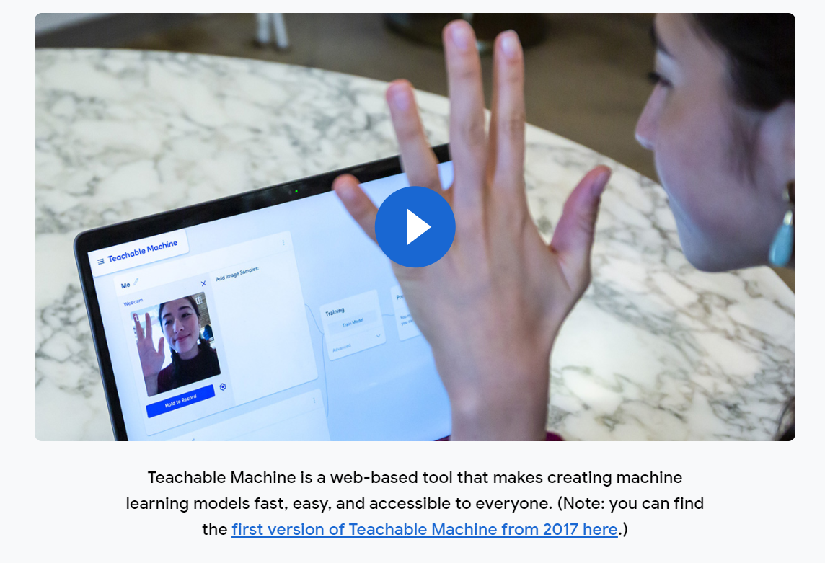
2.4.1 NOW-Teachable Machine
Notes:
(1).减轻梯度消失(vanishing-gradient)。
(2).加强feature传递。
(3).鼓励特征重用(encourage feature reuse)。
(4).较少的参数数量。

Slide 11
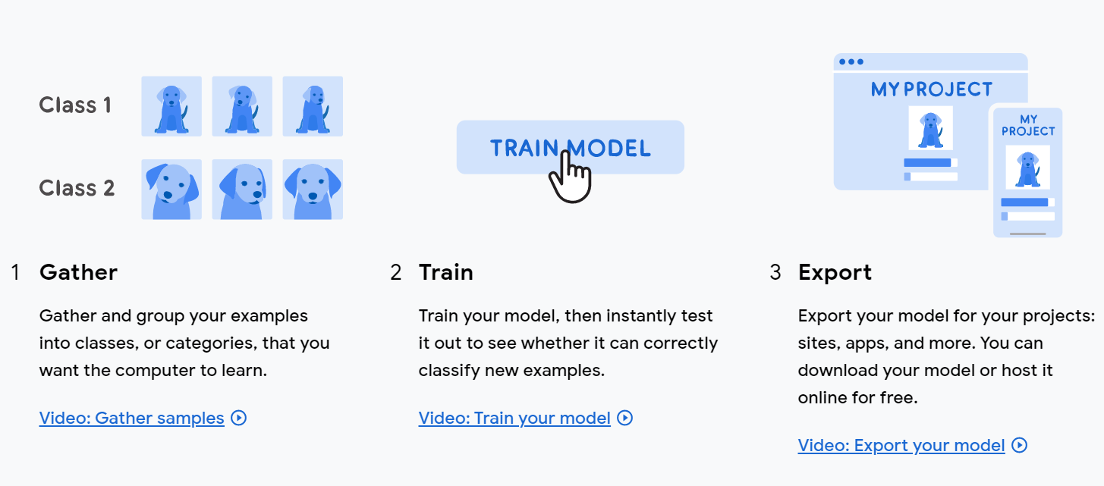
2.4.2 HOW TO USE
Notes:
(1).减轻梯度消失(vanishing-gradient)。
(2).加强feature传递。
(3).鼓励特征重用(encourage feature reuse)。
(4).较少的参数数量。

Slide 12
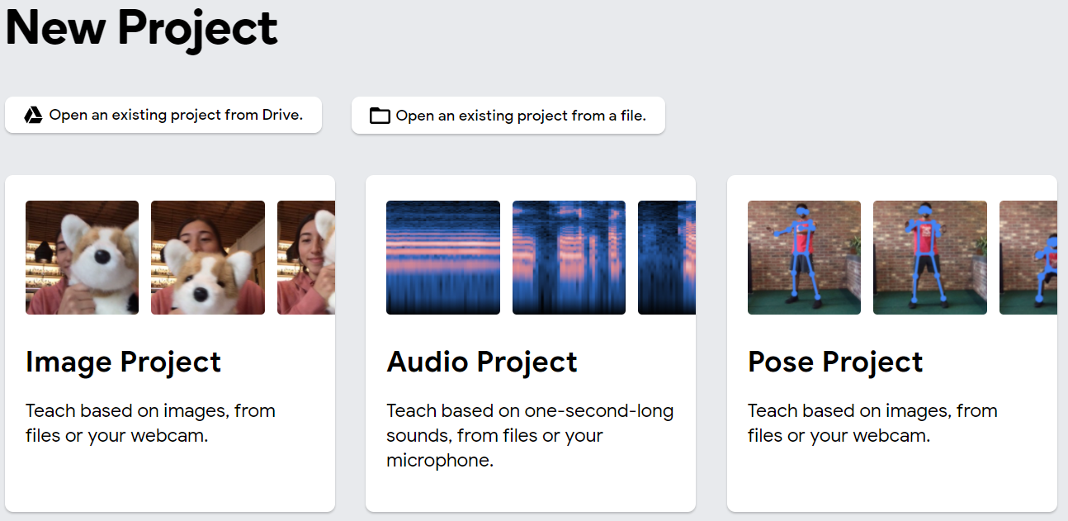
2.4.3 NEW PROJECT
Notes:
(1).减轻梯度消失(vanishing-gradient)。
(2).加强feature传递。
(3).鼓励特征重用(encourage feature reuse)。
(4).较少的参数数量。

Slide 13
PART 3
FEATURES

Slide 14
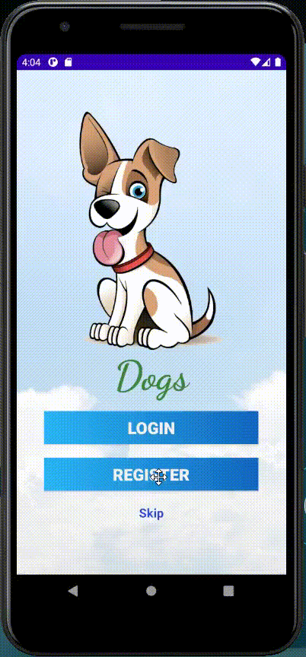
3.1 LOGIN & REGISTER
Step:
Register new account
Login new account

Slide 15
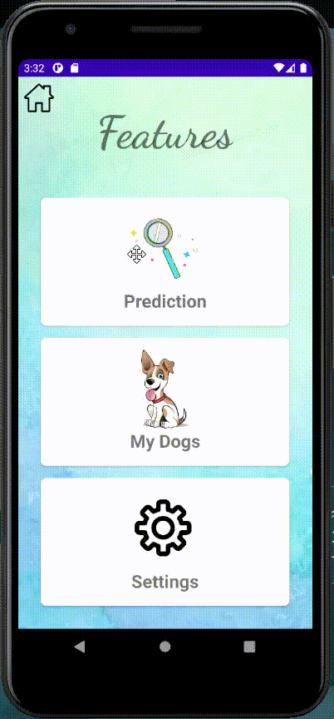
3.2 PREDICTION
Step:
Select image with a dog
Input the data in model
Get the prediction results

Slide 16
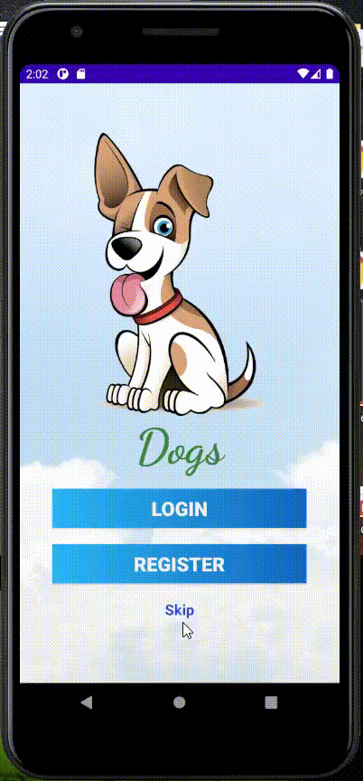
3.3 My Dogs
Step:
Input the dog data
Search the dog

Slide 17
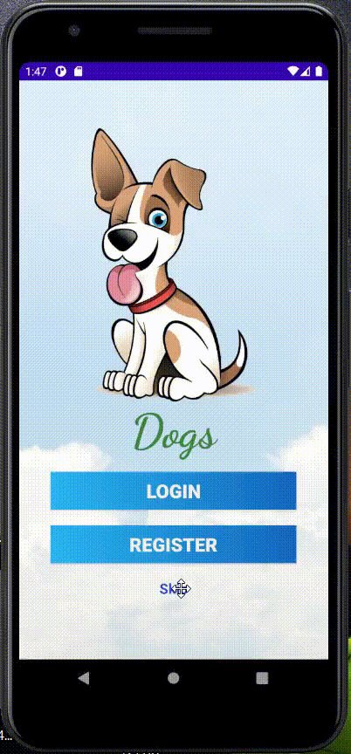
3.4 Setting
Step:
Input old password
Input new password
Now:
ID:072214002
Password:12345678

Slide 18
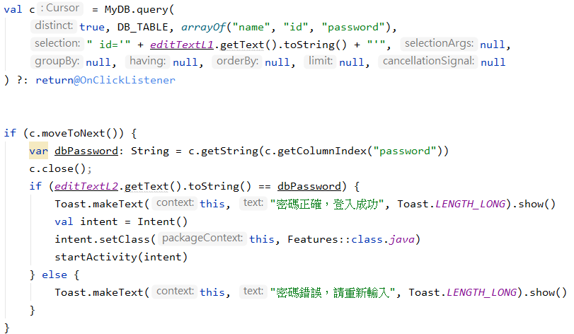
3.5 SQLITE CODE

Slide 19
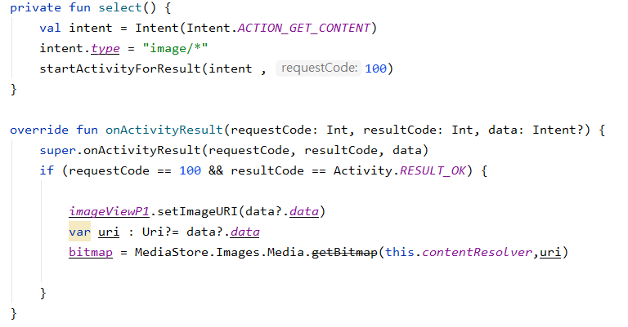
3.6.1 PREDICTION CODE

Slide 20
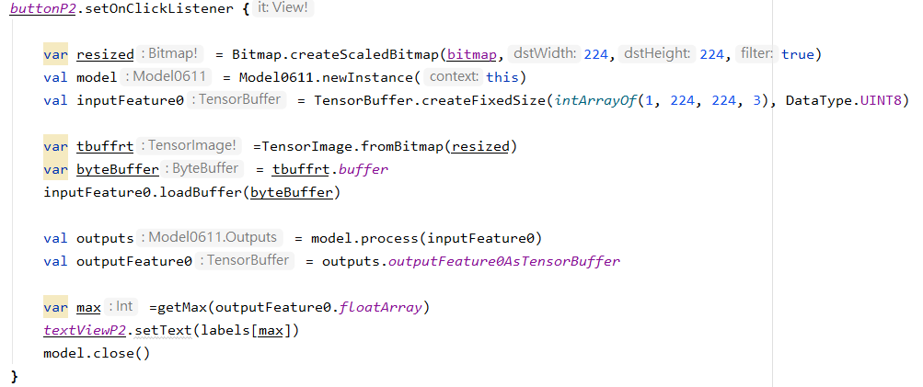
3.6.2 PREDICTION CODE

Slide 21
PART 4
GROW

Slide 22
4.1 GROW
未來期望：
改善影像辨識之標籤數
將即時Chat建構完成
資料庫關聯性改善
更結構化的註冊登入驗證
新增SSO登入功能

Slide 23
PART 5
REFERENCES

Slide 24
5.1 REFERENCES
================================================================
SQLITE參考資料：
[1] Android:用 SQLite 实现 用户的登录查询功能(详解+效果图)
https://reurl.cc/NrqeMe
==============================================================
影像辨識參考資料：
[1] Custom Image Classification on Android using TensorFlow Lite
https://medium.com/analytics-vidhya/custom-image-classification-on-android-using-tensorflow-lite-9f9b3917a26f
[2]image classification | image recognition android app | machine learning app | ml android
https://www.youtube.com/watch?v=6ErbFQb8QS8&t=880s
==============================================================

Slide 25
Thank you for watching
報告人：張家豪
指導老師：蔡坤孝

